Slide 1
MEMORIAL HERMANN MEDICARE ADVANTAGE
2024 Golden Triangle Plan

Slide 2
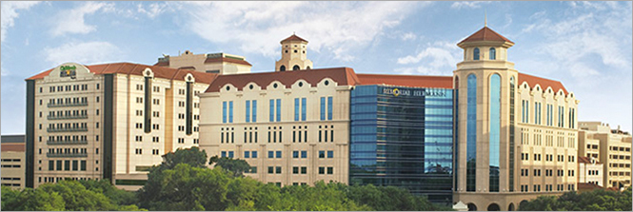
WELCOME

Slide 3
Meeting Agenda
Today’s meeting will cover:
Memorial Hermann Advantage Qualifications
Why Memorial Hermann
Provider Network
Summary of Benefits
Supplemental Benefit Information
Pharmacy
Value-Added Programs
Q&A

Slide 4
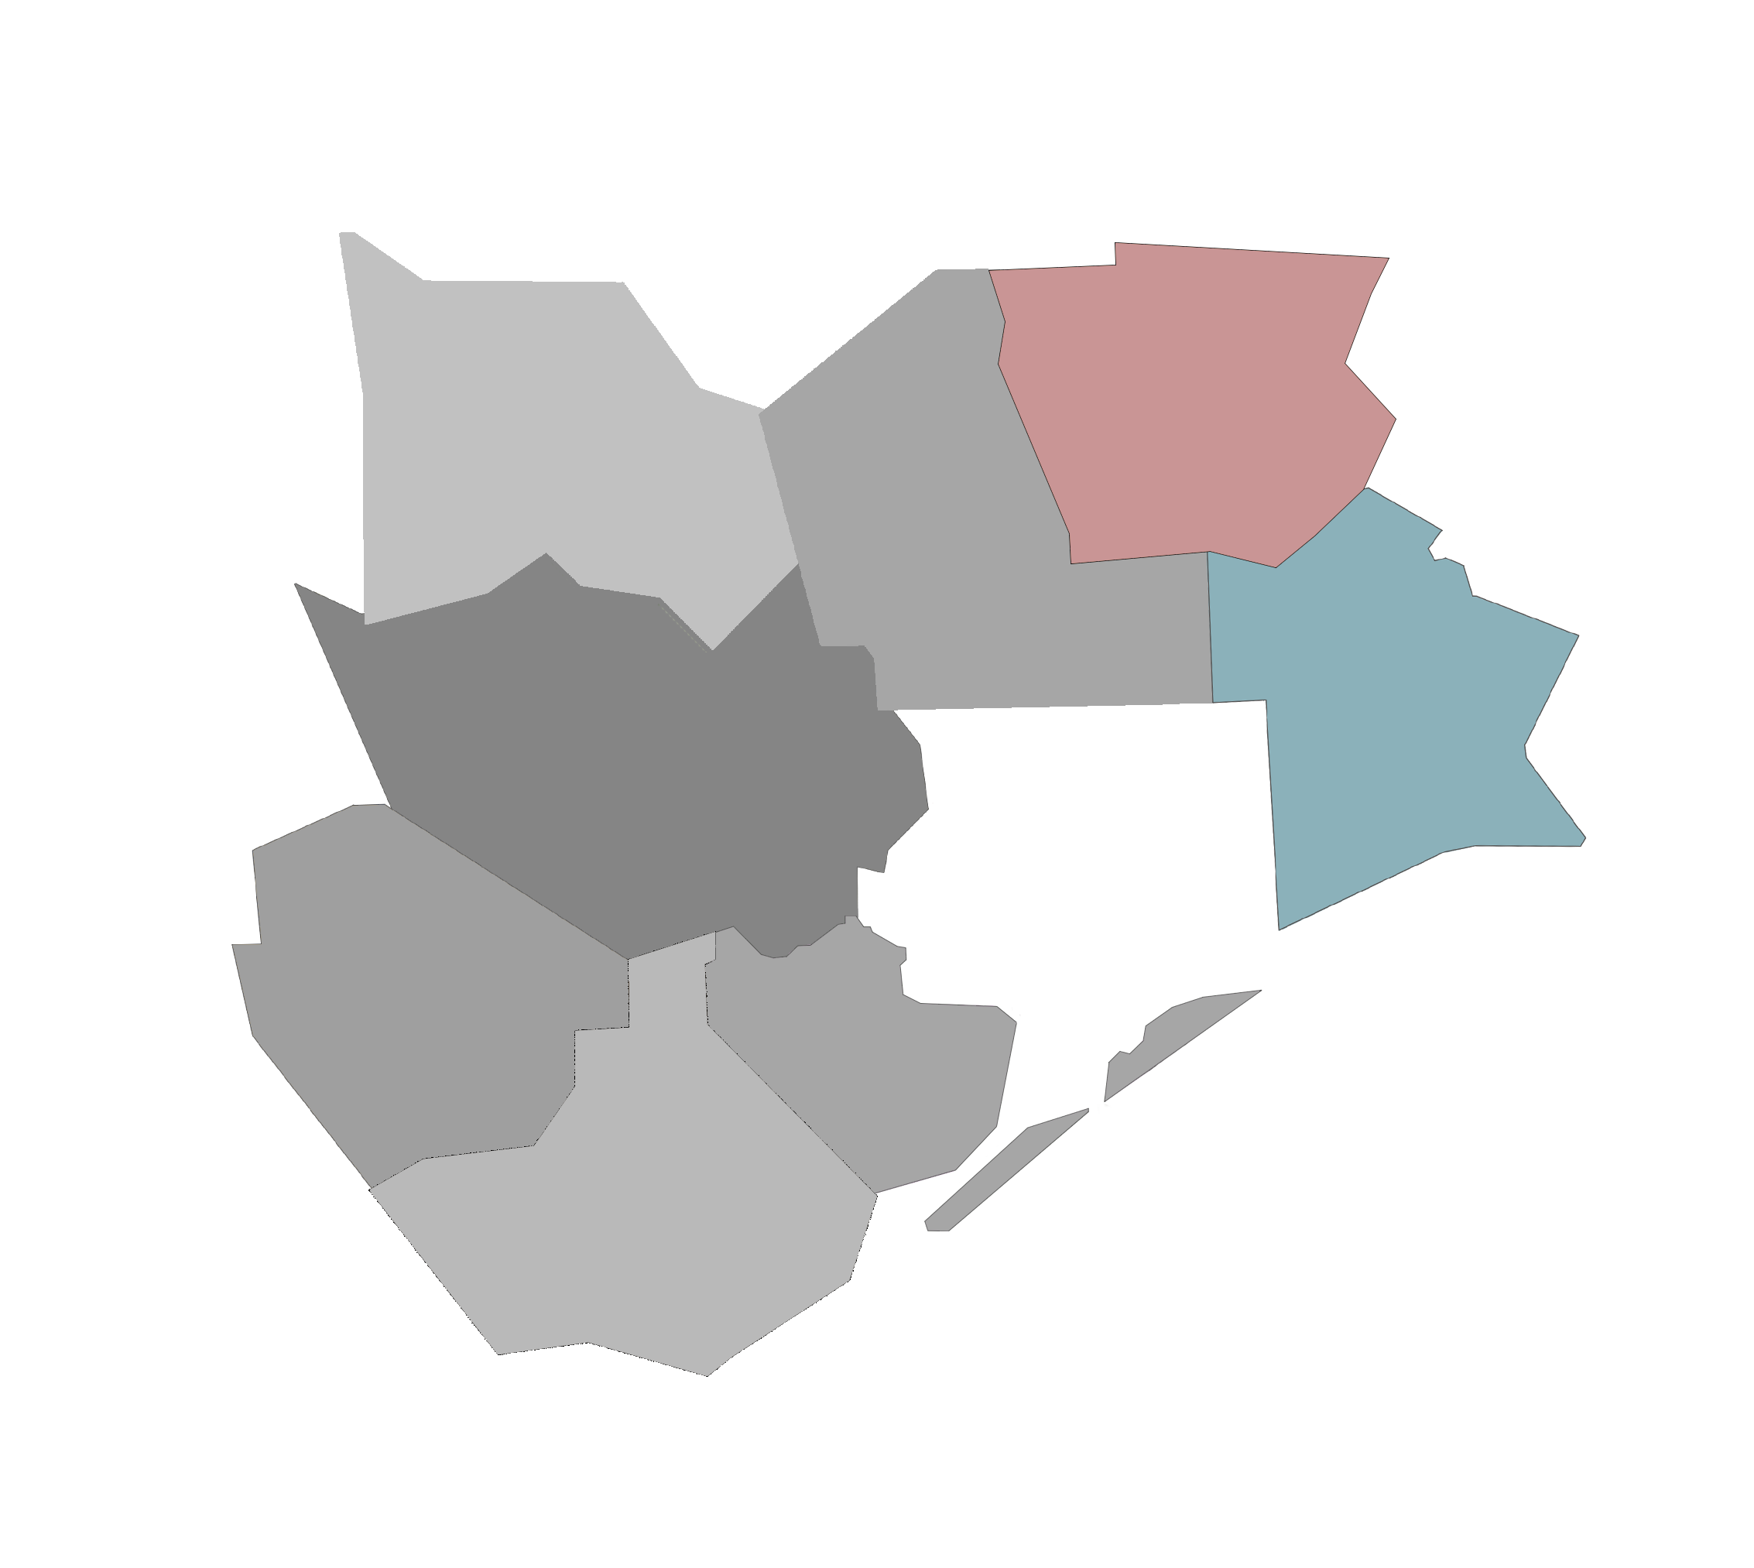
Are you qualified for Memorial Hermann Advantage Golden Triangle?
In order to be eligible for Memorial Hermann Advantage Golden Triangle, you must reside in our coverage area, which includes:
You must also be enrolled in Medicare Part A and B.
Jefferson County
Hardin County
Hardin
Jefferson

Slide 5
Our WHY
A known, respected, LOCAL brand. We are a local plan, serviced locally, to better serve our members and our communities. Memorial Hermann has been helping fellow Texans in the Houston area for over 100 years.
Access to Top-Notch Care with No Referrals. The Memorial Hermann Health System includes over 17 hospitals, 70 clinics, and over 6,700 physicians. And, while we encourage and facilitate establishing a relationship with your PCP to coordinate care, when you’re in our network there are no referrals needed to see a specialist.
Care Coordination: Member – Physician – Pharmacy. We use proprietary technology that efficiently shares valuable information and identifies opportunities for value-based care improvement.
Growth Trajectory. We are investing in our products and our broker partners to significantly drive expansion and growth.
Apex Partnership. Memorial Hermann has partnered with a tech-enabled company dedicated to developing value-based care solutions that address the needs of the member, the hospital, and our approach to sales and retention.
A Concierge Approach to Serving Our Partners. We work directly with our partners to quickly respond to market and customer needs.

Slide 6
Memorial Hermann Provider Network
Your plan includes over 17 hospitals, 70 clinics, and over 6,700 physicians across the Memorial Hermann Health System. We also are partnered with a select group of in-network providers.
Memorial Hermann’s Network growth:
Village Medical Group
UTMB
Unity Physicians
CenterWell
ACE Physicians
New Wave Physicians
Northwest Internal Medicine

Slide 7
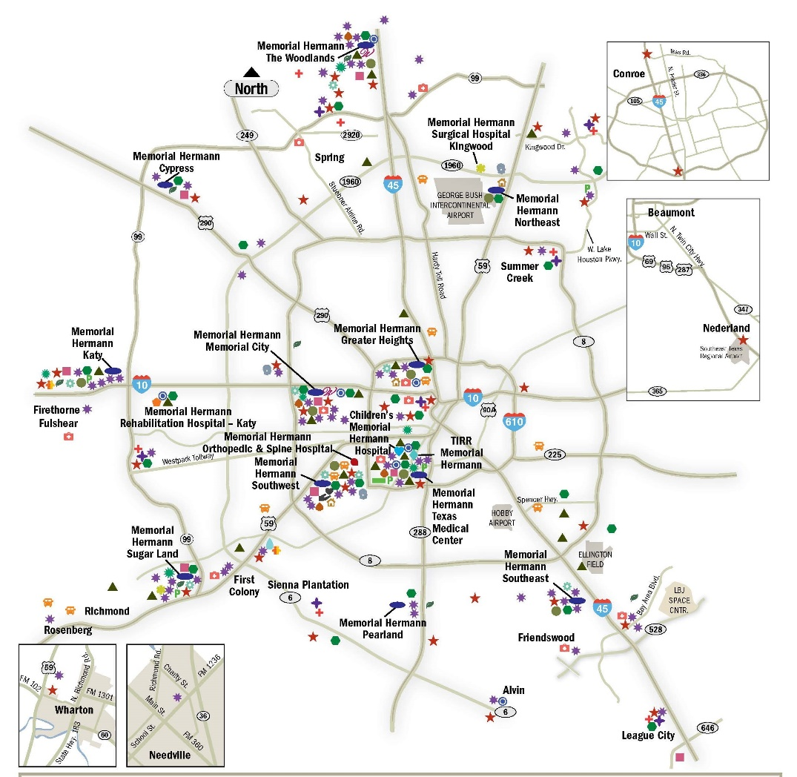
Facilities Network
Memorial Hermann Advantage is backed by the Memorial Hermann Health System —
a trusted name in Houston health care for more than 112 years.
With Memorial Hermann Advantage, you get a high level of care near where you live or work, because Memorial Hermann has numerous facilities throughout Greater Houston, including hospitals, imaging centers, specialty institutes and more.

Slide 8
Summary of Benefits *Advantage Golden triangle plan

Slide 9
2024 Plan Benefits

Slide 10
Plan Information
Benefit | Golden Triangle | What you should know
Monthly Premium | You pay nothing | In addition, you must keep paying your Medicare Part B premium.
Deductible | No deductible | These plans do not have a medical deductible.
Maximum Out-of-Pocket Responsibility (does not include prescription drugs) | You pay no more than $3,200 annually. | This is the most you pay for copays, coinsurance, and other costs for medical services for the 2024 calendar year.

Slide 11
Plan Information
Benefit | Golden Triangle | What you should know
Inpatient Hospital Coverage | You pay $350 per stay. | Our plans cover an unlimited number of days for an inpatient hospital stay. Requires prior authorization.
Outpatient Hospital Coverage | You pay $125 for each Medicare-covered outpatient hospital facility visit.
­­­Doctors Visits | Primary Care Physician Visit: You pay $0 per visit Specialist Visit: You pay $20 per visit | For detailed information regarding additional in office cost shares by Physician/Specialist, see the Medical Benefits Chart in Chapter 4 of the Evidence of Coverage (EOC). Please note: With limited exceptions, you must receive care from network providers.

Slide 12
Plan Information
Benefit | Golden Triangle | What you should know
Preventive Care | You pay nothing | Any additional preventive services approved by Medicare during the contract year will be covered. For Colorectal Cancer Screenings, please note that a colonoscopy or sigmoidoscopy conducted for polyp removal or biopsy is a surgical procedure subject to the outpatient surgery cost sharing described later in this benefit grid.
Emergency Care | You pay $125 per visit | If you are admitted to the hospital within 48 hours, you do not have to pay your share of the cost for emergency care.
Urgent Care | You pay $25 per visit

Slide 13
Plan Information
Benefit | Golden Triangle | What you should know
Diagnostic Labs | You pay nothing | Costs for these services may be different if received in an outpatient surgery setting.
Diagnostic Radiology Services (such as MRIs, CT and PET scans) | You pay $150 per test/procedure | Prior Authorization required for diagnostic radiology services.
Lab Services | You pay $0 per lab service
Therapeutic radiology services (such as radiation treatment for cancer) | You pay $25 per session
Outpatient X-rays | You pay $0 per x-ray

Slide 14
Plan Information
Benefit | Golden Triangle | What you should know
NEW 2024: Flex Card | Vision and/or Hearing Allowance: $900 OTC: $140/quarter via catalog or brick-and-mortar pharmacy locations. Groceries: $500 - ONLY if enrolled in Case Management & Approved by a Case Manager
Dental Services | Preventive/Comprehensive Dental: Covered up to $2,500 annual max Medicare Covered Dental Services: $20 | For a complete description of this benefit, including any additional limitations and exclusions, please refer to the Liberty Dental outline.

Slide 15
Plan Information
Benefit | Golden Triangle | What you should know
Wellness Programs | Silver&Fit® Program: You pay nothing | Memorial Hermann Advantage offers Silver&Fit® club membership, Home Fitness Program, fitness challenges and more.
Telehealth/ Virtual Care Services * | $0.00 copay for Nurse line. $0.00 copay for Telephonic Physician visits. $0.00 copay for virtual visit (Evisits) through Memorial Hermann | 24/7 Nurse line services through toll free telephone number. 24/7 Telephonic Physician visits available nationwide through Teladoc. Virtual visit (Evisit) through Memorial Hermann - hours are limited and is available throughout Texas. * Services scheduled through your physicians office may be subject to corresponding cost share
Durable Medical Equipment/Supplies | You pay 20% coinsurance | Prior Authorization required for items over $500.

Slide 16
Plan Information
Benefit | Golden Triangle | What you should know
Mental Health Services (including Inpatient) | Psychiatric Services: $20 Opioid Treatment Program Services: $20 Mental Health Specialist Non-Physician: $0 | Inpatient visit: Our plan covers an unlimited number of days for an inpatient hospital stay. Prior Authorization required.
Skilled Nursing Facility | You pay nothing for days 1 through 20. You pay $125 per day for days 21 through 100. | Prior Authorization required.
Medicare Part B Drugs | For Part B drugs such as chemotherapy drugs: You pay 20% coinsurance Other Part B Drugs Including Allergy Injections: You pay 20% coinsurance
Foot Care (podiatry services) | Foot exams and treatment Routine Foot Care: You pay $20 | Limitations may apply.

Slide 17
Plan Information
Benefit | Golden Triangle | What you should know
Rehabilitation Services | Cardiac (heart) Rehab Services: You pay $0 per visit Pulmonary Services: You pay $0 per visit Occupational Therapy Visit: You pay $35 per visit Physical Therapy and Speech and Language Therapy Visit: You pay $35 per visit
Ambulance | Ground - You pay $250 per one-way trip Air – You pay 20%
Transportation | Memorial Hermann Advantage Golden Triangle HMO covers 10 trips.
Over-the-Counter (OTC) | $40 per quarter
Meals | Coverage: (10) meals post-discharge of inpatient or surgical hospital stay | Limitations may apply.

Slide 18
SUPPLEMENTAL BENEFIT INFORMATION

Slide 19
Dental
Liberty Dental (3rd Year)
Dramatically improved preventive/comprehensive annual maximum
Co-pays for each service for member clarity – no coinsurance
Helpful Member Information:
Liberty has an excellent network in the Houston area, and members can find a provider by calling Liberty at: 866.674.0114 (TTY: 877.855.8039).
Or, the member can visit the Liberty website at:
https://client.libertydentalplan.com/MemorialHermannMedicare/FindADentist

Slide 20
Transportation
Important benefit for the most at-risk members
Increased need as Houston grows and we increase our membership
20 covered trips for Golden Triangle
Doubled number of trips in the Base plan and MA Only plan
Helpful Member Information:
Members can call Modivcare directly to reserve a ride (recommend three days in advance when possible): 855.330.9138
Or, visit their website at www.mymodivcare.com and click “Book a Ride.” Member will be instructed to set up a username and password, which can be used to quickly log-in and book future trips.

Slide 21
Meals
10 prepared meals delivered to member post in-patient hospitalization
Available on all plans
Helpful Member Information:
If the member is working with a Case Manager already, the Case Manager can order the meals after the member has been discharged.
The Member also has up to 14 days post discharge to order the meals themselves by calling Memorial Hermann Customer Service at: 855.645.8448 (TTY: 711).
Meals typically arrive in 2-3 days and can be refrigerated for up to two weeks.

Slide 22
Flexible Spending Card
Vision/Hearing Combined Amount
OTC – Quarterly via catalog (Medline) or brick-and-mortar
Grocery benefit if in Case Management and approved by Case Manager
Flex card includes web site address for member portal:
Check balances
Review purchases/locations
Request reimbursement if card wasn’t available
App also available

Slide 23
PHARMACY
2024 PHARMACY UPDATES

Slide 24
Initial Coverage: Retail Cost-Sharing
Tier | One-Month Supply at a Preferred Pharmacy | Three-Month Supply at a Preferred Pharmacy | One-Month Supply at a Non-Preferred Pharmacy | Three-Month Supply at a Non-Preferred Pharmacy
Tier 1 (Preferred Generic) | $0.00 | $0.00 | $10.00 | $20.00
Tier 2 (Generic) | $5.00 | $10.00 | $18.00 | $36.00
Tier 3 (Preferred Brand) | $39.00 | $78.00 | $47.00 | $94.00
Tier 4 (Non-Preferred Brand) | $92.00 | $184.00 | $100.00 | $200.00
Tier 5 (Specialty Tier Drugs) | 33% | N/A | 33% | N/A
Tier 6 (Select Care Drugs) | $0.00 | $0.00 | $8.00 | $16.00

Slide 25
Golden Triangle: Mail Order Cost-Sharing
Tier | 90 Day Supply
Tier 1 (Preferred Generic) | $0.00
Tier 2 (Generic) | $10.00
Tier 3 (Preferred Brand) | $78.00
Tier 4 (Non-Preferred Brand) | $184.00
Tier 5 (Specialty Tier Drugs) | 33%
Tier 6 (Select Care Drugs) | $0.00

Slide 26
Prescription Drug Coverage Plan Highlights
New for 2024:
Simplified benefit
No more preferred vs non preferred pharmacy
Tier 2 – Non-preferred generics
Now covered at $0 copay
Memorial Hermann Specialty Pharmacy
Lumicera
Memorial Hermann specialty pharmacy options:

Slide 27
Plan Prescription Highlights
Preferred Diabetic Vendors
One Touch (LifeScan products) and Accu-Chek (Roche products ) are 0% coinsurance for preferred/exclusive brand of glucometer & test strips. Majority of our current members use these products and can enjoy savings! 20% coinsurance for all other Medicare-covered diabetic supplies.
Continuous Glucose Monitors (CGM) are covered at the Pharmacy!
Continuous Glucose Monitors (CGM) are covered through your pharmacy benefit. Please check the formulary for any restrictions and for tier information. Preferred CGM brands are DexCom G6 and Freestyle Libre. All others are excluded.
Select Care drugs
Select Care Drugs (Tier 6) are certain generic medications commonly used to treat diabetes, high blood pressure and cholesterol. These drug are available at preferred pharmacies and through mail order services at $0 copay.
Select Care Drugs (Tier 6) drugs are fully covered during coverage gap (donut hole) at $0 copay at preferred pharmacies or Costco mail order service!

Slide 28
HMO Plans Prescription Drug Coverage:
2024 Memorial Hermann Prescription Drug Benefit
Total Yearly Drug Cost (Cost paid by you and our Part D plan) | $5,030.00
For more information on the additional pharmacy-specific cost-sharing and the phases of the benefit, please call us at 855.645.8448 (TTY 711) available 8 a.m. to 8 p.m. CST, seven days per week from October 1 – March 30 and 8 a.m. to 8 p.m. CST, Monday – Friday from April 1st - September 30; or access our Evidence of Coverage at healthplan.memorialhermann.org/medicare.
You may get your drugs at network retail pharmacies and mail order pharmacies. If you reside in a long-term care facility, you pay the same as at a retail pharmacy.

Slide 29
Coverage Gap & Catastrophic Coverage
Coverage Gap:
Most Medicare drug plans have a coverage gap (also called the "donut hole"). This means that there's a temporary change in what you will pay for your drugs. The coverage gap begins after the total yearly drug cost (including what our plan has paid and what you have paid) reaches $5,030.
After you enter the coverage gap, you pay 25% of the price for brand name drugs, plus a portion of the dispensing fee and 25% of the price for generic drugs. Not everyone will enter the coverage gap.
Catastrophic Coverage:
After your yearly out-of-pocket drug costs (including drugs purchased through your retail pharmacy and through mail order) reach $8,000, you pay the greater of:
$0 Member Cost Share per Inflation Reduction Act.***
5% of the cost, or
$4.15 copay for generic or a preferred multi-source drug (including brand drugs treated as generic) and a
$10.35 copay for all other drugs

Slide 30
VALUE-ADDED PROGRAMS
2024 PROGRAMS

Slide 31
Silver&Fit® Fitness Program
The Silver&Fit® Exercise and Healthy Aging program includes the following benefits*:
No-cost fitness facility access Enjoy no-cost fitness facility memberships to a broad network of participating locations. Participating locations including 24-hour Fitness, local YMCAs, and Planet Fitness, and more.
The Home Fitness Program Choose one home fitness kit, including free Fit Bit, yoga mat and more each benefit year to keep you active at home, even if you can't make it to a fitness facility.
Resource Library Get The Silver Slate® newsletter along with Healthy Aging videos and booklets. Stay motivated and social by engaging in fitness challenges with your friends.
Silver&Fit Connected!™ Track and view your activity levels through wearable fitness devices or mobile applications.
Rewards program Earn fun rewards like hats and collector pins for staying active.
*Visit SilverandFit.com to learn more.

Slide 32
Healthy Advantage Wellness Program
The Memorial Hermann Healthy Advantage Wellness Program rewards members for certain health-related activities. We are offering a MasterCard gift card that can be used anywhere MasterCard is accepted.
Each reward will vary based on the type of service completed during the current plan year.
You do not have to return anything back to the plan. Also, we'll track your completed wellness activities
on your behalf!
$25 Annual Health Risk Assessment
$50 Annual Wellness/Comprehensive visit
$25 Breast Cancer screening
$50 Colon Cancer screening
$30 Retinal Eye Exam for Diabetics (excluding Glaucoma screening)*
*Subject to vision care benefit coverage as outlined in the Evidence of Coverage.
The Healthy Advantage Wellness Program and reward gift care are not a plan benefit. Gift card reward is not redeemable for cash.

Slide 33
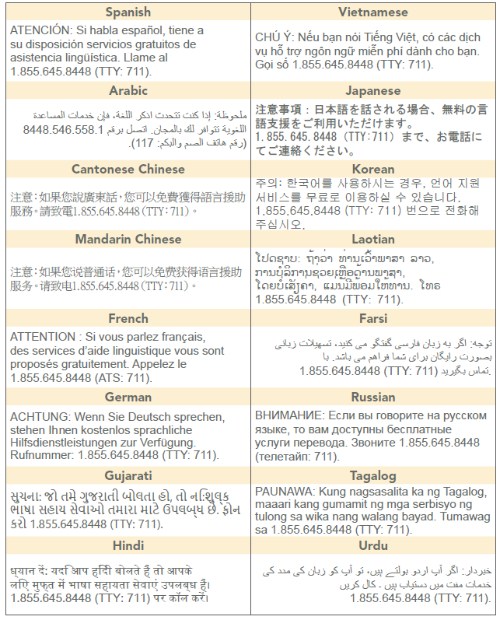
Language Support Services
*Resources are available for the visually impaired.
Memorial Hermann Advantage complies with applicable Federal civil rights laws and does not discriminate on the basis of race, color, national origin, age, disability, or sex.
This information is not a complete description of benefits. Call 855.645.8448 (TTY 711) for more information.
Copyright © 2023 Memorial Hermann. All rights reserved.
H7115_MKAEPGoldenTriangle24_M CMS Approved 9/11/2023

Slide 34
Language Support Services
Memorial Hermann Advantage complies with applicable Federal civil rights laws and does not discriminate on the basis of race, color, national origin, age, disability, or sex. Memorial Hermann Advantage does not exclude people or treat them differently because of race, color, national origin, age, disability, or sex.
Memorial Hermann Advantage:
Provides free aids and services to people with disabilities to communicate effectively with us, such as: Qualified sign language interpreters. Written information in other formats (large print, audio, accessible electronic formats, other formats)
Provides free language services to people whose primary language is not English, such as:
Qualified interpreters
Information written in other languages
If you need these services, contact Customer Service at the number below.
If you believe that Memorial Hermann Advantage has failed to provide these services or discriminated in another way on the basis of race, color, national origin, age, disability, or sex, you can file a grievance with:
Civil Rights Coordinator, Memorial Hermann Health Plan, 11740 Katy Freeway, 5th Floor., Houston, TX 77079
855.645.8448 (TTY 711) 8 a.m. to 8 p.m. 7 days a week CST.
Fax 713.338.6487
Email MHHealthAppeals@memorialhermann.org
You can file a grievance in person or by mail, fax, or email. If you need help filing a grievance, the Civil Rights Coordinator is available to help you. You can also file a civil rights complaint with the U.S. Department of Health and Human Services, Office for Civil Rights electronically through the Office for Civil Rights Complaint Portal, available at https://ocrportal.hhs.gov/ocr/portal/lobby.jsf, or by mail or phone at: U.S. Department of Health and Human Services, 200 Independence Avenue SW., Room 509F, HHH Building, Washington, DC 20201, 1.800.368.1019, 800.537.7697 (TDD).
Complaint forms are available at http://www.hhs.gov/ocr/office/file/index.html.

Slide 35
Questions?

